Slide 1



{{HEADLINE}}
{{PRICE}}
{{SIZE_LABEL}}
{{SIZE}}
ZONING
{{ZONING}}
{{PPU_LABEL}}
{{PPU}}
LOCATION {{ADDRESS}}, {{CITY}}, {{STATE}} {{ZIP}} ({{COUNTY}} County)
SUMMARY {{COVER_SUMMARY}} Three or four sentences: the story, the size, the location and who it suits.
{{AGENT_NAME}}
{{AGENT_TITLE}}
{{AGENT_PHONE}} {{AGENT_EMAIL}}
{{TEAM_NAME}} | {{WEBSITE}}

Slide 2
AT A GLANCE
{{PRICE}}
Asking Price
{{SIZE}}
{{SIZE_LABEL}}
{{PPU}}
{{PPU_LABEL}}
{{ZONING}}
Zoning
{{STAT_5}}
{{STAT_5_LABEL}}
{{STAT_6}}
{{STAT_6_LABEL}}
{{STAT_7}}
{{STAT_7_LABEL}}
{{STAT_8}}
{{STAT_8_LABEL}}
The Opportunity
{{OPPORTUNITY}} One full paragraph: who owns it and why it is for sale, what is on the site, access and traffic, nearby employers and what kinds of buyers it suits.
{{AGENT_NAME}}
{{AGENT_TITLE}}
{{AGENT_PHONE}} {{AGENT_EMAIL}}
{{TEAM_NAME}} | {{WEBSITE}}

Slide 3

PROPERTY HIGHLIGHTS
PROPERTY HIGHLIGHTS
{{HIGHLIGHT_1}}
{{HIGHLIGHT_2}}
{{HIGHLIGHT_3}}
{{HIGHLIGHT_4}}
{{HIGHLIGHT_5}}
{{HIGHLIGHT_6}}
{{HIGHLIGHT_7}}
{{HIGHLIGHT_8}}
{{HIGHLIGHT_9}}
{{HIGHLIGHT_10}}
LOCATION HIGHLIGHTS
{{LOCATION_1}}
{{LOCATION_2}}
{{LOCATION_3}}
{{LOCATION_4}}
{{LOCATION_5}}
{{LOCATION_6}}
{{AGENT_NAME}}
{{AGENT_TITLE}}
{{AGENT_PHONE}} {{AGENT_EMAIL}}
{{TEAM_NAME}} | {{WEBSITE}}

Slide 4
HIGHEST & BEST USE
What the site is best suited for
PRIMARY USE
{{USE_1_TITLE}}
{{USE_1_TEXT}} Why this use fits: traffic, nearby users, growth, the site itself.
SECONDARY USE
{{USE_2_TITLE}}
{{USE_2_TEXT}} Why this use fits: traffic, nearby users, growth, the site itself.
VALUE ADD
{{USE_3_TITLE}}
{{USE_3_TEXT}} Why this use fits: traffic, nearby users, growth, the site itself.
What a buyer will need to plan for
{{CONSIDERATION_1}}
{{CONSIDERATION_2}}
{{CONSIDERATION_3}}
{{CONSIDERATION_4}}
Broker's opinion of potential uses based on available information. Not a zoning, engineering or appraisal determination.
{{AGENT_NAME}}
{{AGENT_TITLE}}
{{AGENT_PHONE}} {{AGENT_EMAIL}}
{{TEAM_NAME}} | {{WEBSITE}}

Slide 5






PROPERTY PHOTOS
{{AGENT_NAME}}
{{AGENT_TITLE}}
{{AGENT_PHONE}} {{AGENT_EMAIL}}
{{TEAM_NAME}} | {{WEBSITE}}

Slide 6






PROPERTY PHOTOS
{{AGENT_NAME}}
{{AGENT_TITLE}}
{{AGENT_PHONE}} {{AGENT_EMAIL}}
{{TEAM_NAME}} | {{WEBSITE}}

Slide 7
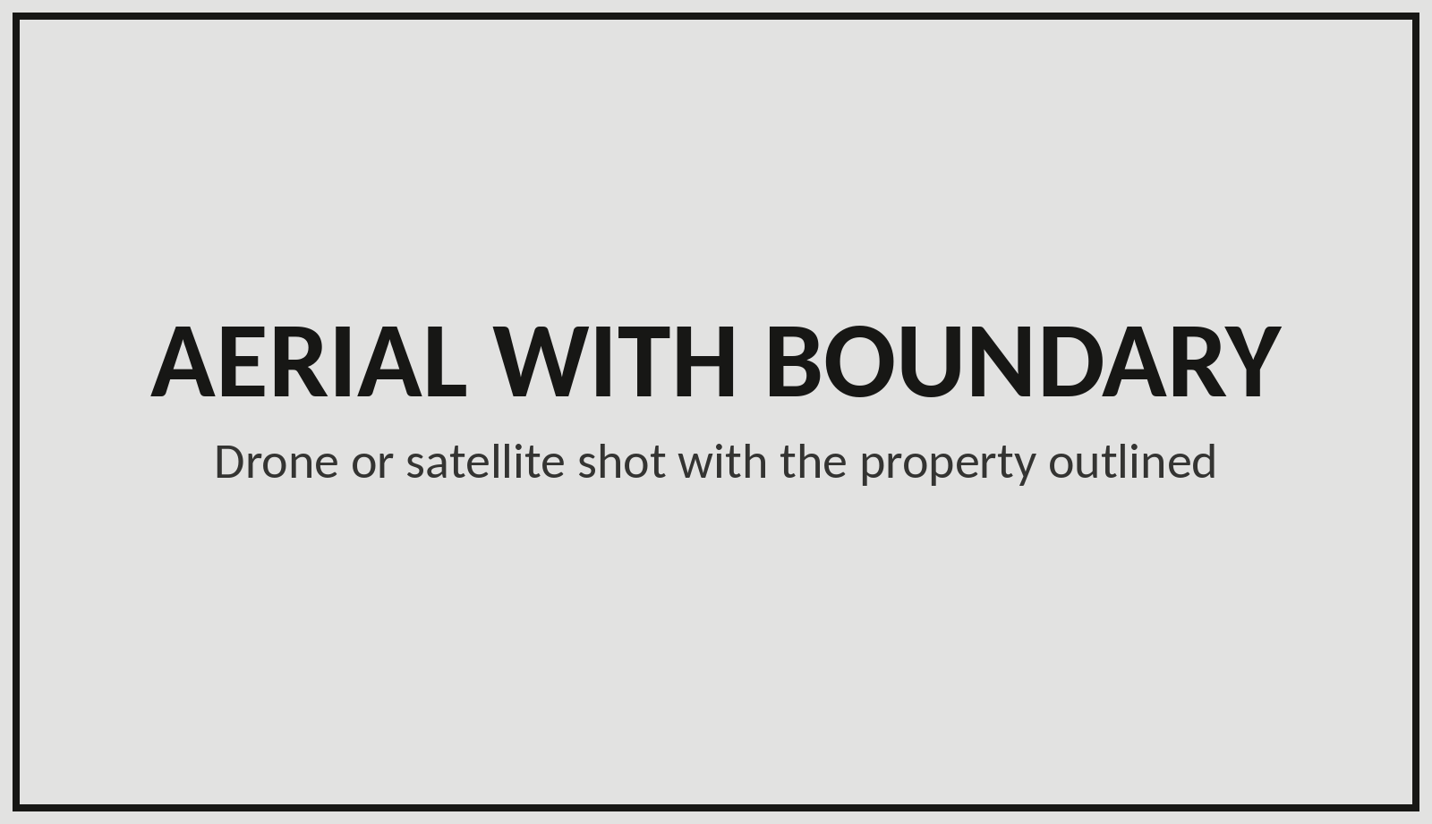
AERIAL MAP
{{AGENT_NAME}}
{{AGENT_TITLE}}
{{AGENT_PHONE}} {{AGENT_EMAIL}}
{{TEAM_NAME}} | {{WEBSITE}}

Slide 8
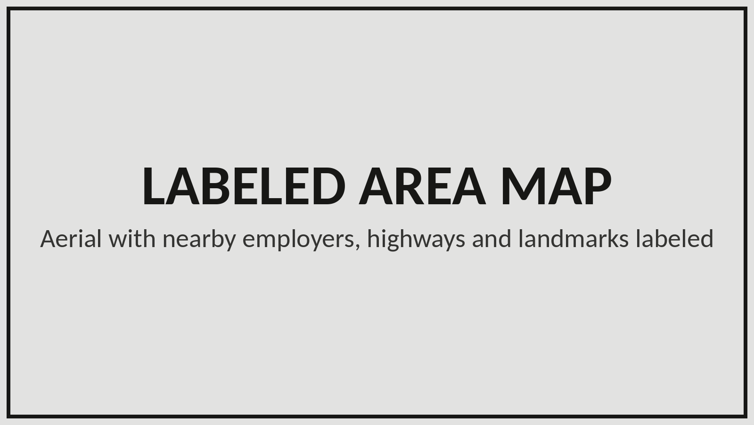
AERIAL MAP
{{AGENT_NAME}}
{{AGENT_TITLE}}
{{AGENT_PHONE}} {{AGENT_EMAIL}}
{{TEAM_NAME}} | {{WEBSITE}}

Slide 9

SURVEY
{{AGENT_NAME}}
{{AGENT_TITLE}}
{{AGENT_PHONE}} {{AGENT_EMAIL}}
{{TEAM_NAME}} | {{WEBSITE}}

Slide 10
SALE COMPARABLES
{{BEST_COMP_PPU}}
Best comp: {{BEST_COMP_NAME}}
{{BEST_COMP_NOTE}}
{{AVG_COMP_PPU}}
Average price per {{UNIT}}
{{COMP_COUNT}} sales, {{COMP_YEARS}}
{{PPU}}
Subject price per {{UNIT}}
{{SIZE}} {{UNIT}}s at {{PRICE}}
Property | County | Sold | Price | Size | $/Unit | Miles
SUBJECT: {{ADDRESS}} | {{COUNTY}} | Listed | {{PRICE}} | {{SIZE}} | {{PPU}} | -
{{COMP_1}}
{{COMP_2}}
{{COMP_3}}
{{COMP_4}}
{{COMP_5}}
{{COMP_6}}
{{COMP_7}}
{{COMP_8}}
Source: {{COMP_SOURCE}}. Miles measured straight-line from the subject.
{{AGENT_NAME}}
{{AGENT_TITLE}}
{{AGENT_PHONE}} {{AGENT_EMAIL}}
{{TEAM_NAME}} | {{WEBSITE}}

Slide 11
DEMOGRAPHICS
Who lives near the site
Rings measured from {{ADDRESS}}, {{CITY}}, {{STATE}} {{ZIP}}
 | 1 MILE | 3 MILES | 5 MILES
Population | {{POP_1}} | {{POP_3}} | {{POP_5}}
Households | {{HH_1}} | {{HH_3}} | {{HH_5}}
Avg. household size | {{HHSIZE_1}} | {{HHSIZE_3}} | {{HHSIZE_5}}
Median age | {{AGE_1}} | {{AGE_3}} | {{AGE_5}}
Median household income | {{INCOME_1}} | {{INCOME_3}} | {{INCOME_5}}
Median home value | {{HOMEVAL_1}} | {{HOMEVAL_3}} | {{HOMEVAL_5}}
Source: U.S. Census Bureau, American Community Survey 5-year estimates. Ring figures are estimates.
{{AGENT_NAME}}
{{AGENT_TITLE}}
{{AGENT_PHONE}} {{AGENT_EMAIL}}
{{TEAM_NAME}} | {{WEBSITE}}

Slide 12
MARKET OVERVIEW
Traffic: daily vehicle counts near the site
{{TRAFFIC_1}}
{{TRAFFIC_1_ROAD}}
{{TRAFFIC_1_WHERE}}
{{TRAFFIC_2}}
{{TRAFFIC_2_ROAD}}
{{TRAFFIC_2_WHERE}}
{{TRAFFIC_3}}
{{TRAFFIC_3_ROAD}}
{{TRAFFIC_3_WHERE}}
Growth: ZIP code {{ZIP}}
{{ZIP_POP}}
Population ({{YEAR}})
{{ZIP_POP_NOTE}}
{{ZIP_GROWTH}}
Growth since 2020
{{ZIP_GROWTH_NOTE}}
{{DAYTIME_POP}}
Daytime population
people in the area on workdays
Sources: {{MARKET_SOURCES}}
{{AGENT_NAME}}
{{AGENT_TITLE}}
{{AGENT_PHONE}} {{AGENT_EMAIL}}
{{TEAM_NAME}} | {{WEBSITE}}

Slide 13

ABOUT US
{{AGENT_BIO}} Three or four short first-person paragraphs: years in commercial real estate, markets and property types, recent work, and how you help clients. The agent approves it before it ships.
{{AGENT_NAME}}
{{AGENT_PHONE}}
{{AGENT_NAME}}
{{AGENT_TITLE}}
{{AGENT_PHONE}} {{AGENT_EMAIL}}
{{TEAM_NAME}} | {{WEBSITE}}

Slide 14

BROKERAGE DISCLOSURE
{{AGENT_NAME}}
{{AGENT_TITLE}}
{{AGENT_PHONE}} Mobile
{{OFFICE_PHONE}} Office
{{AGENT_EMAIL}}
{{TEAM_NAME}} | {{WEBSITE}}

Slide 15
CONFIDENTIALITY & DISCLAIMER
This Offering Memorandum was prepared by {{TEAM_NAME}} to help prospective purchasers evaluate {{ADDRESS}}, {{CITY}}, {{STATE}} {{ZIP}} (the "Property"). It is confidential and may not be copied or shared with anyone other than the recipient's advisors without the broker's written consent.
The information in this memorandum was obtained from sources believed to be reliable, including the seller, public records, the U.S. Census Bureau and third-party data providers. However, the broker and seller make no warranty or representation, expressed or implied, as to its accuracy or completeness. Size, zoning, utilities, floodplain, traffic counts, demographics and potential uses are estimates or opinions and must be independently verified.
Prospective purchasers should conduct their own investigation of the Property, including survey, title, environmental, zoning, utility and floodplain review, and consult their own legal, tax and engineering advisors.
The seller reserves the right to accept or reject any offer, and to change the price or terms or withdraw the Property from the market, at any time without notice. Only a fully executed purchase contract will bind the seller.
Brokerage services are provided by {{BROKERAGE_LEGAL_NAME}}, license {{BROKERAGE_LICENSE}}. Each SVN® office is independently owned and operated.
{{AGENT_NAME}}
{{AGENT_TITLE}}
{{AGENT_PHONE}} {{AGENT_EMAIL}}
{{TEAM_NAME}} | {{WEBSITE}}

